Slide 1

Pittsburgh Penguins Business Intelligence Analyst Final Interview
Nithin Ragunathan
Thursday July 21st, 2022

Slide 2

Project Goal
To Showcase data analysis and visualization skillsets using NHL attendance data

Slide 3
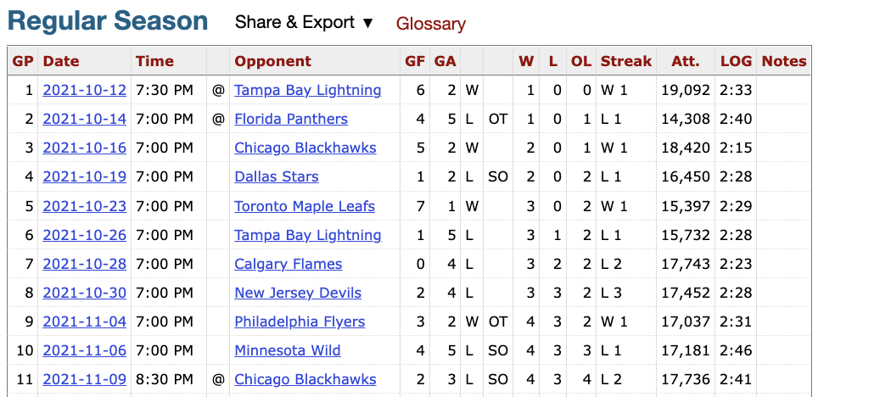
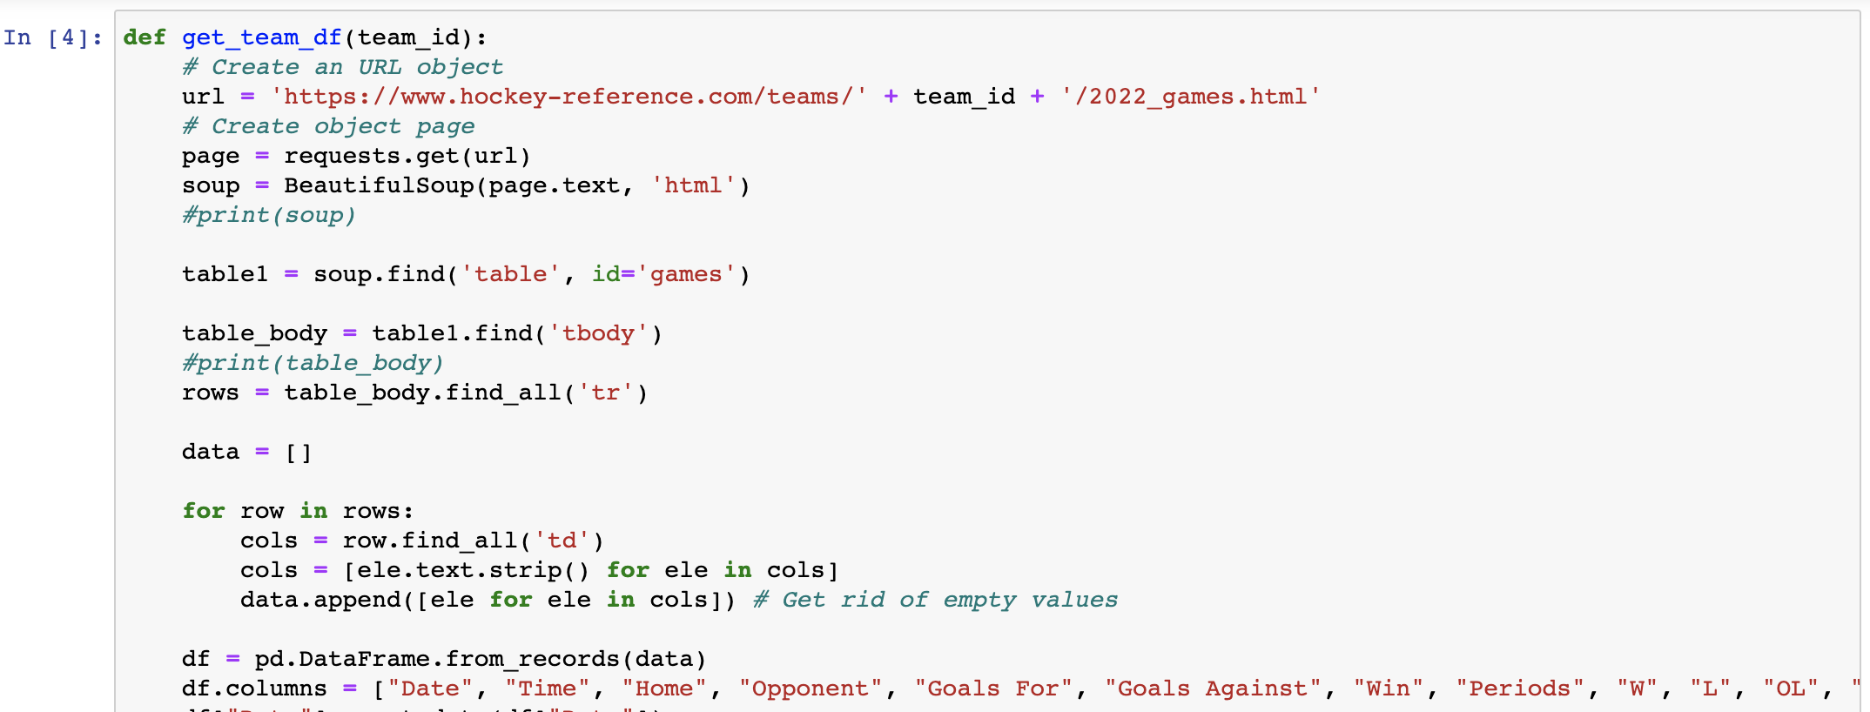
Data Collection
Source: https://www.hockey-reference.com
HTML table scraped from the web using the BeautifulSoup package (Python)

Slide 4




Development Tools
Python
BeautifulSoup Webscraper
Pandas library
SQL
Database instance storing attendance data for 32 NHL teams and all 1312 regular season games
Tableau
Data visualization and Dashboarding

Slide 5

Demo

